Slide 1
Cryogenic Properties of Materials
J. G. Weisend II

Slide 2
Goals
Describe the issues associated with use of materials at cryogenic temperatures
List suitable and unsuitable materials for use in cryogenic systems
Give the physical explanation behind the variation of some material properties with temperature
Provide pointers to material properties

Slide 3
Issues with Materials at
Cryogenic Temperatures
Material properties change significantly with temperature. These changes must be allowed for in the design.
Many materials are unsuitable for cryogenic use.
Material selection must always be done carefully. Testing may be required.

Slide 4
Material Selection
Some suitable materials for cryogenic use include:
  Austenitic stainless steels e.g. 304, 304L, 316, 321
  Aluminum alloys e.g. 6061, 6063, 1100
  Copper e.g. OFHC, ETP and phosphorous deoxidized
  Brass
  Fiber reinforced plastics such as G –10 and G –11
  Niobium & Titanium (frequently used in superconducting RF systems)
    But becomes brittle at cryogenic temperatures
  Invar (Ni /Fe alloy) useful in making washers due to its lower coefficient of expansion
  Indium (used as an O ring material)
  Kapton and Mylar (used in Multilayer Insulation and as electrical insulation
  Quartz (used in windows)

Slide 5
Material Selection
Unsuitable materials include:
  Martensitic stainless steels Undergoes ductile to brittle transition when cooled down.
  Cast Iron – also becomes brittle
  Carbon steels – also becomes brittle. Sometimes used in 300 K vacuum vessels but care must be taken that breaks in cryogenic lines do not cause the vacuum vessels to cool down and fail.
  Rubber, Teflon and most plastics (important exceptions are Kel-F and UHMW used as seats in cryogenic valves)

Slide 6
Thermal Expansivity
Large amounts of contraction can occur when materials are cooled to cryogenic temperatures.
Points to consider:
  Impact on alignment
  Development of interferences or gaps due to dissimilar materials
  Increased strain and possible failure
  Impact on wiring
  Most contraction occurs above 77 K

Slide 7
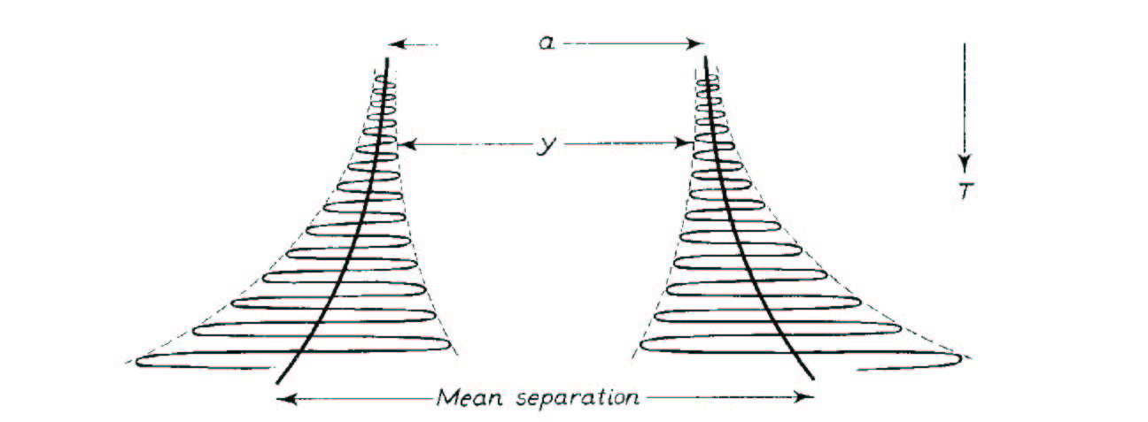
Thermal Expansivity
α=1/L (δL/δT)
Results from anharmonic component in the potential of the lattice vibration

Slide 8
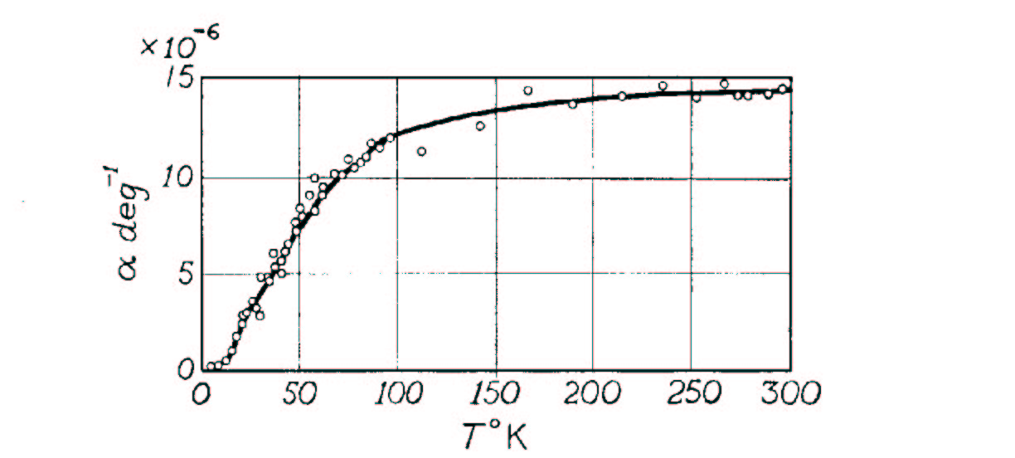
Thermal Expansivity
α goes to 0 at 0 slope as T approaches 0 K
α is T independent at higher temperatures
For practical work the integral thermal contraction is more useful

Slide 9
Integral Thermal Contraction
Material | ΔL / L ( 300 – 100 ) | ΔL / L ( 100 – 4 )
Stainless Steel | 296 x 10 ⁻⁵ | 35 x 10 ^{–5}
Copper | 326 x 10 ⁻⁵ | 44 x 10 ⁻⁵
Aluminum | 415 x 10 ⁻⁵ | 47 x 10 ⁻⁵
Iron | 198 x 10 ⁻⁵ | 18 x 10 ⁻⁵
Invar | 40 x 10 ⁻⁵ | -
Brass | 340 x 10 ^{–5} | 57 x 10 ⁻⁵
Epoxy/ Fiberglass | 279 x 10 ^{–5} | 47 x 10 ⁻⁵
Titanium | 134 x 10 ⁻⁵ | 17 x 10 ⁻⁵

Slide 10
Heat Capacity or
Specific Heat of Solids
C = dU/dT or Q/mDT
In general, at cryogenic temperatures, C decreases rapidly with decreasing temperature.
This has 2 important effects:
  Systems cool down faster as they get colder
  At cryogenic temperatures, small heat leaks may cause large temperature rises
Where is the heat stored ?
  Lattice vibrations
  Electrons (metals)
The explanation of the temperature dependence of the specific heat of solids was an early victory for quantum mechanics

Slide 11
Lattice Contribution
Dulong Petit Law
Energy stored in a 3D oscillator = 3NkT = 3RT
Specific heat = 3R = constant
  Generally OK for T= 300 K or higher
  Doesn’t take into account quantum mechanics

Slide 12
Einstein &
Debye Theories
Einstein explains that atoms may only vibrate at quantized amplitudes. Thus:
This results in a temperature dependent specific heat
Debye theory accounts for the fact that atoms in a solid aren’t independent & only certain frequencies are possible

Slide 13
Debye Theory
The Debye theory gives the lattice specific heat of solids as:
As T ~ 300 K C~ 3R (Dulong Petit)
At T< θ/10 C varies as T ³

Slide 14
Impact of Electrons in Metals on Specific Heat
Thermal energy is also stored in the free electrons in the metal
Quantum theory shows that electrons in a metal can only have certain well defined energies
Only a small fraction of the total electrons can be excited to higher states & participate in the specific heat
It can be shown that C_{e} = γT

Slide 15
Specific Heat of Solids
The total specific heat of metals at low temperatures may be written:
C = AT³ +BT - the contribution of the electrons is only important at < 4 K
Paramagnetic materials and other special materials have anomalous specific heats -always double check

Slide 16
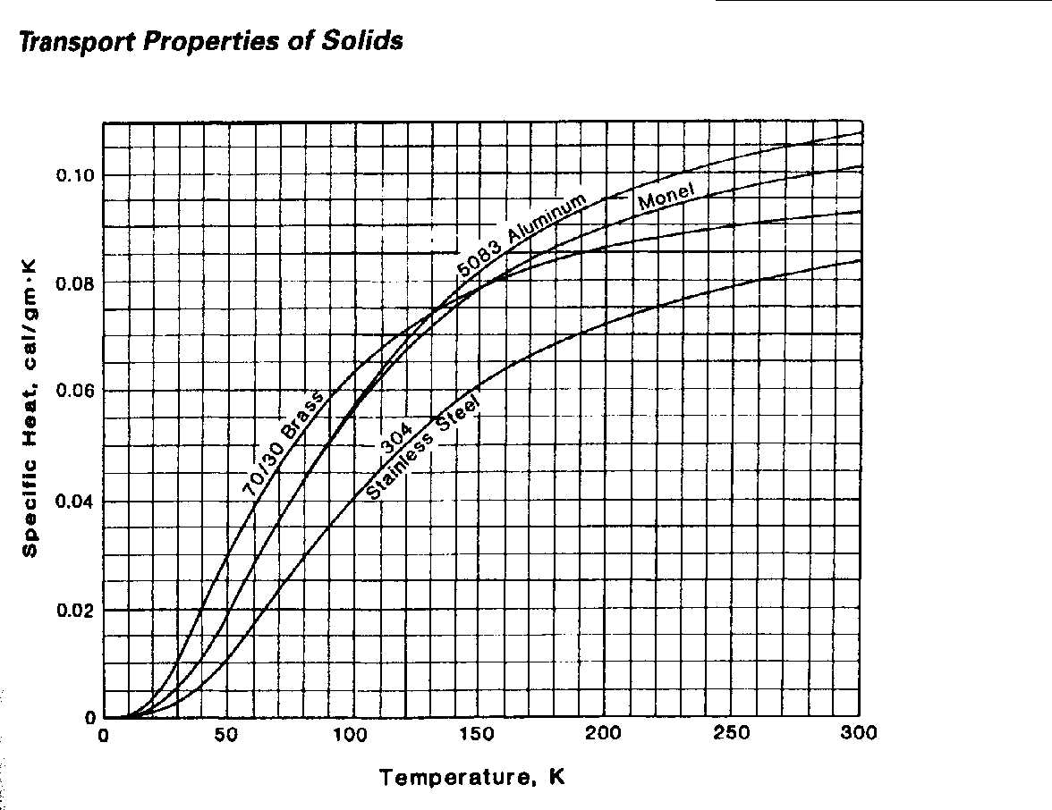
Specific Heat of Common Metals

Slide 17
Thermal Conductivity
Q = -K(T) A(x) dT/dx
K Varies significantly with temperature
Temperature dependence must be considered when calculating heat transfer rates

Slide 18
Thermal Conductivity of Metals
Energy is transferred both by lattice vibrations (phonons) and conduction electrons
In “reasonably pure” metals the contribution of the conduction electrons dominates
There are 2 scattering mechanisms for the conduction electrons:
  Scattering off impurities (W_{o} = β/T)
  Scattering off phonons (W_{i} = αT²)
The total electronic resistivity has the form :
W_{e} = αT² + β/T

Slide 19
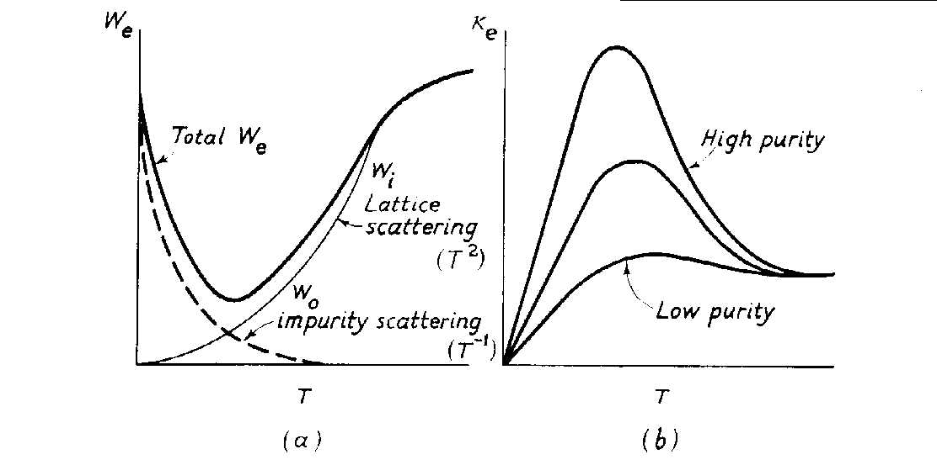
Thermal Conductivity of Metals Due to Electrons
From Low Temperature Solid State Physics –Rosenburg
The total electronic resistivity has the form : W_{e} = aT² + b/T K~ 1/We

Slide 20
Heat Conduction by
Lattice Vibrations in Metals
Another mechanism for heat transfer in metals are lattice vibrations or phonons
The main resistance to this type of heat transfer is scattering of phonons off conduction electrons
This resistance is given by W = A/T²
Phonon heat transfer in metals is generally neglected

Slide 21
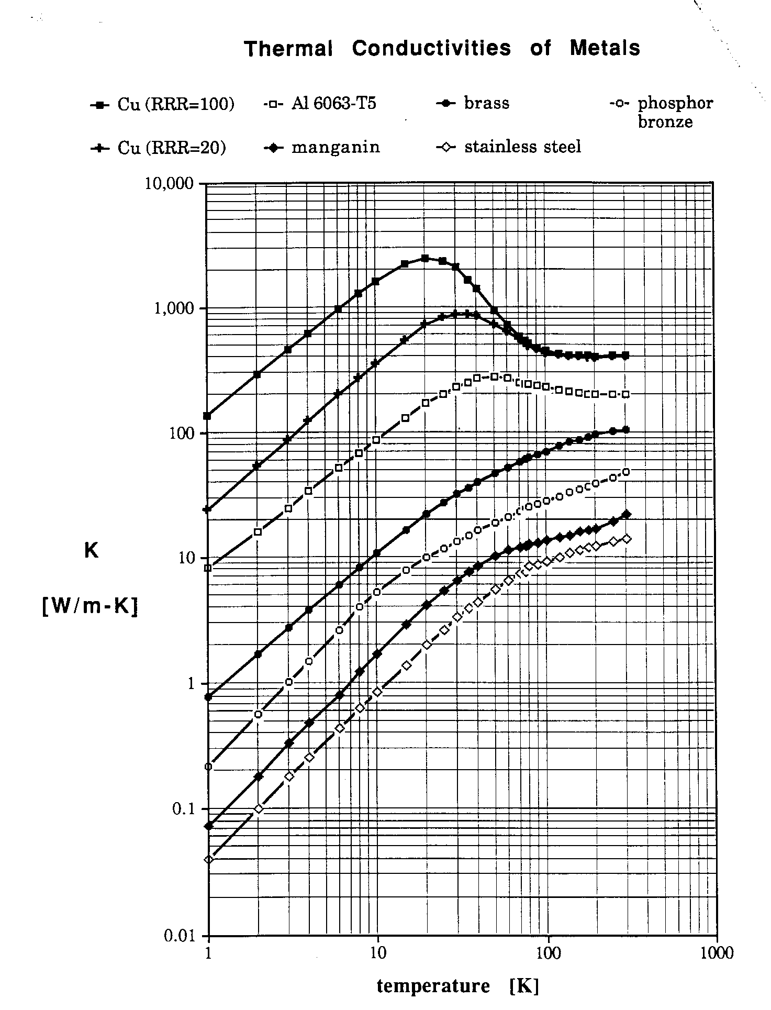
Thermal Conductivities of Metals
From Lakeshore Cryotronics

Slide 22
Thermal Conductivity
Integrals
The strong temperature dependence of K makes heat transfer calculations difficult
The solution is frequently to use thermal conductivity integrals
The heat conduction equation is written as:

Slide 23
Thermal Conductivity
Integrals
G is the geometry factor
θ is the thermal conductivity integral

Slide 24
Thermal Conductivity
Integrals
Advantages:
  Simple
  Only end point temperatures are important. (assuming there are no intermediate heat sinks) The actual temperature distribution is not.
  Thermal conductivity integrals have been calculated for many engineering materials
  This is quite useful for heat leak calculations

Slide 25
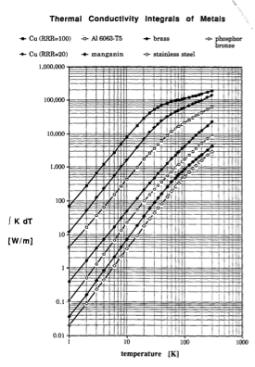
Thermal Conductivity
Integrals of Metals
From Handbook of Cryogenic Engineering, J. Weisend II (Ed)

Slide 26
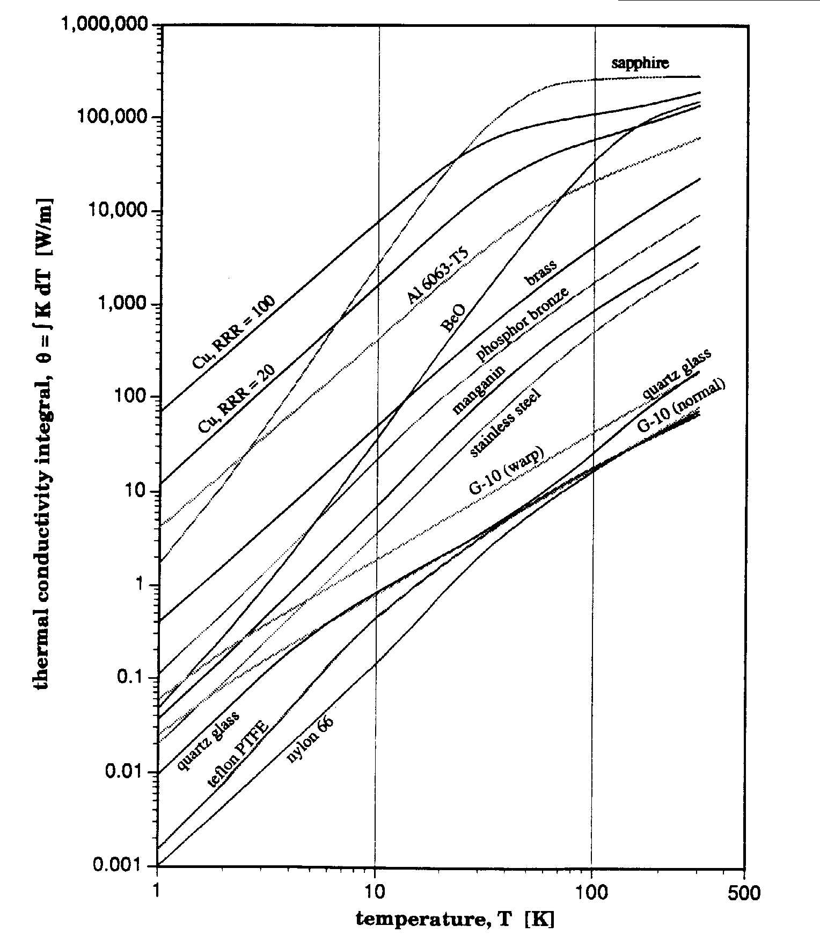
Thermal Conductivity Integrals of
Metals & Nonmetals

Slide 27
Electrical Resistivity
Ohm’s Law V=IR
  R=ρL/A where ρ is the electrical resistivity
Conduction electrons carry the current & there are 2 scattering mechanisms
  Scattering of electrons off phonons
  Scattering of electrons off impurities or defects (e.g. dislocations)

Slide 28
Electrical Resistivity of Metals
For T ~ θ phonon scattering dominates
  ρ is proportional to T
For T<< θ impurity scattering dominates
  ρ is constant
Between these two regions (T~ θ/3)
  ρ is proportional to T⁵ for metals
RRR = ρ (300 K)/ρ (4.2K) an indication of metal purity
Notes:
In the superconducting RF world, a significant amount of effort is expended in trying to produce high RRR Niobium. In general, high RRR materials have better thermal conductivities and this allows for more efficient heat transfer from the inside of the cavity to the helium coolant.

Slide 29
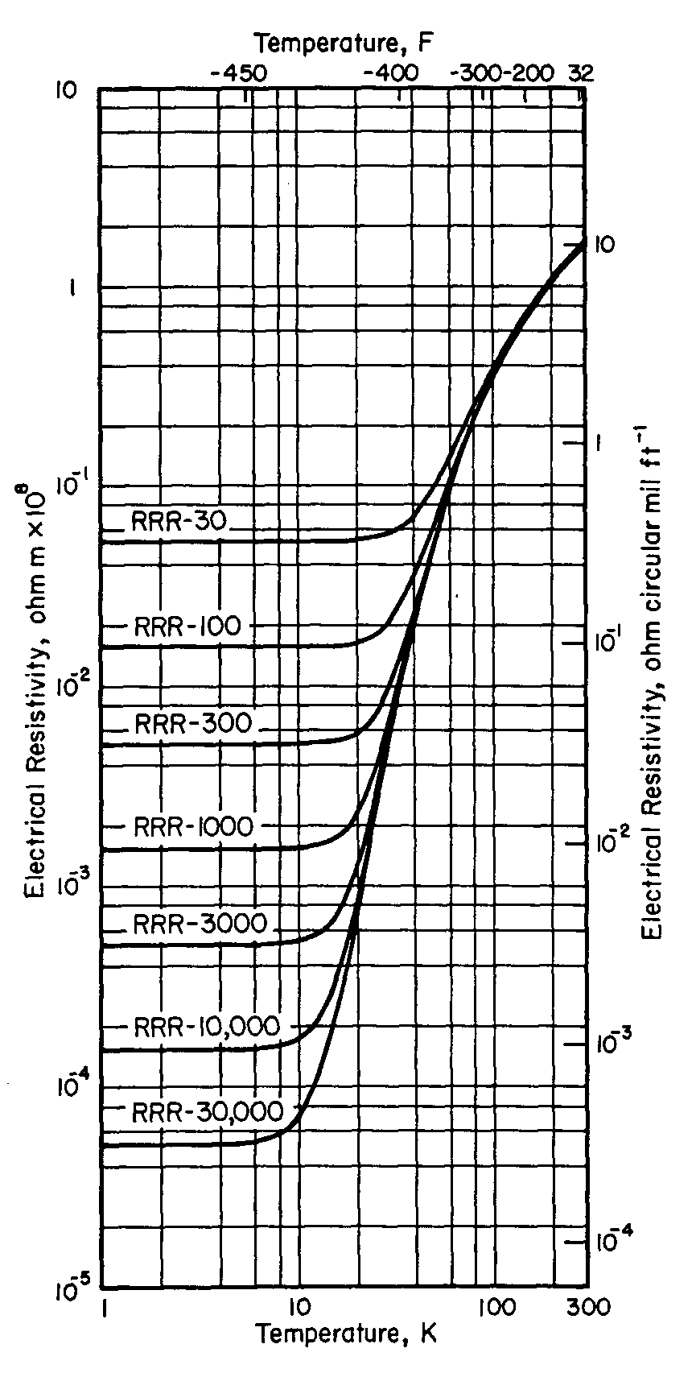
Electrical Resistivity of Copper
Electrical Resistivity of Copper
From Handbook of Materials for Superconducting Machinery (1974)

Slide 30
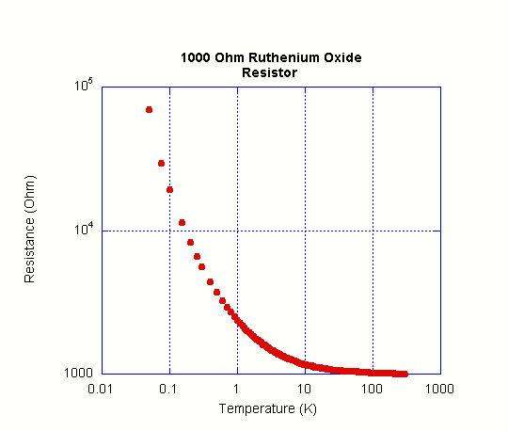
Electrical Resistivity of Other Materials
Amorphous materials & semiconductors have very different resistivity characteristics than metals
The resistivity of semiconductors is very non linear & typically increases with decreasing T due to fewer electrons in the conduction band
Superconductivity – A later lecture

Slide 31
Material Strength
Tends to increase at low temperatures (as long as there is no ductile to brittle transition)
300 K values are typically used for conservative design. Remember all systems start out at 300 K & may unexpectedly return to 300 K.
Always look up values or test materials of interest

Slide 32
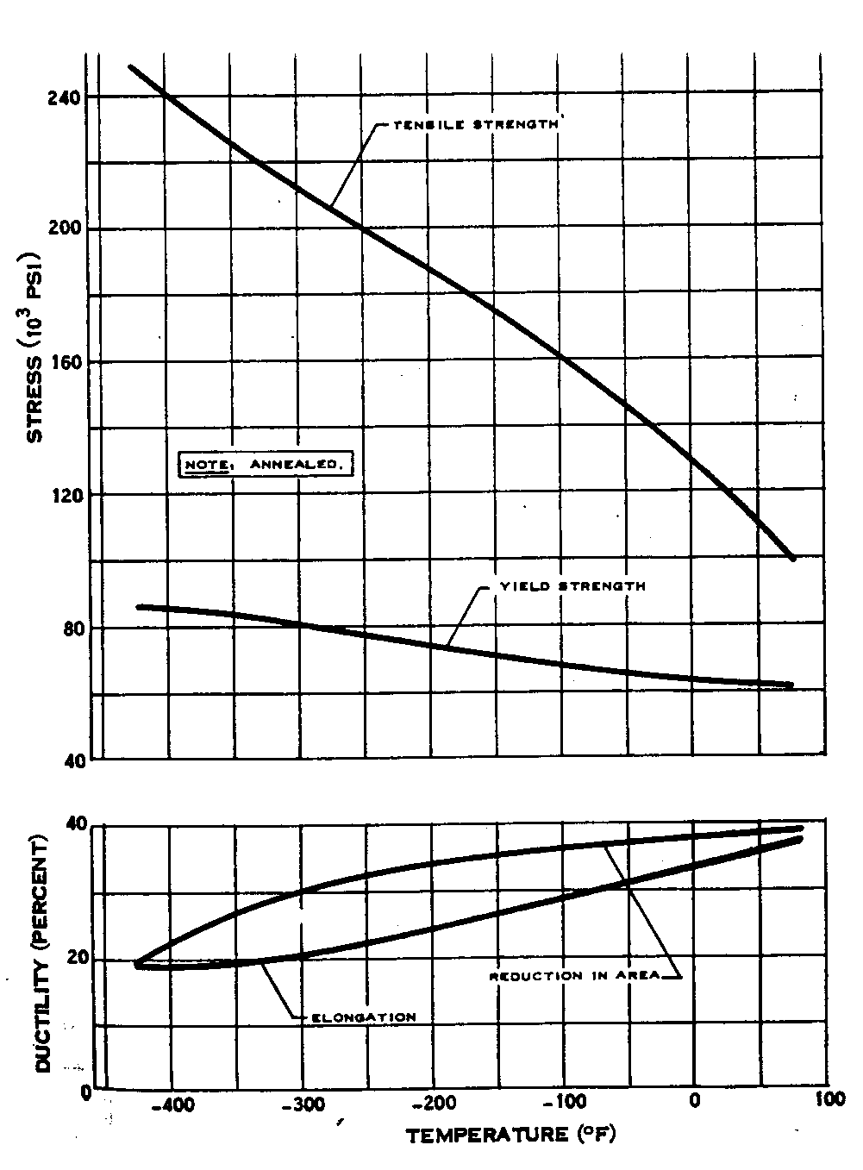
Typical Properties of 304 Stainless Steel
From Cryogenic Materials Data Handbook (Revised)
Schwartzberg et al ( 1970)

Slide 33
Superconductivity
As we’ve seen, superconductivity is a major motivating factor for the use of cryogenics – particularly in scientific applications but also in commercial systems such as MRI
Cryogenic engineers will frequently be called upon to design systems to cool and keep cold superconducting equipment
Thus, understanding the requirements of superconductors is an important part of the training of a cryogenic engineer.
What is a superconductor?
  A superconductor is a material that conducts DC electrical current with zero resistive losses under certain specific conditions
    When in the superconducting state the resistive loss is identically zero not just vanishingly small but zero

Slide 34
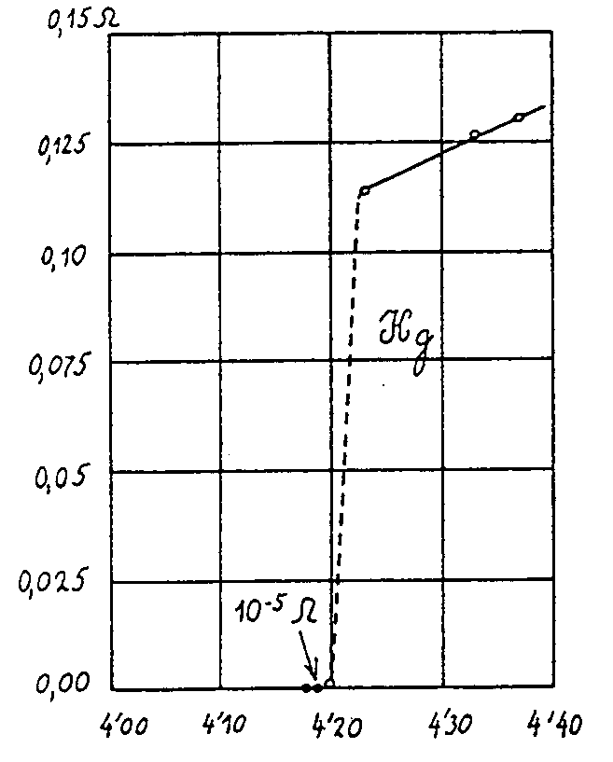
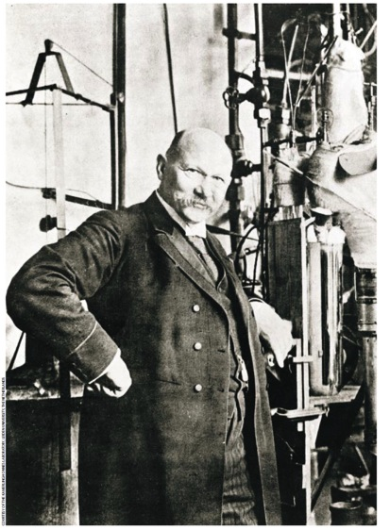
Discovery of Superconductivity
H. Kamerlingh-Onnes June 9, 1911 – University of Leiden
  Kamerlingh-Onnes had previously been the first to liquefy helium in 1908
  Having liquid helium available enabled this discovery

Slide 35
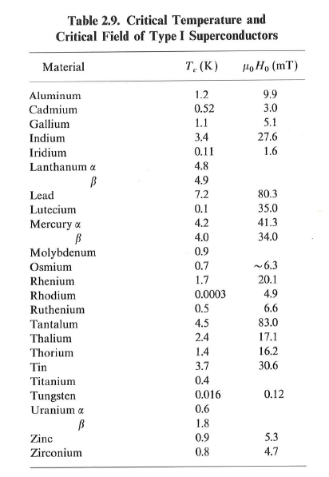
Conditions for Superconductivity
Critical Temperature
  All superconductors have a temperature above which they no longer become superconducting
This is an obvious condition but by no means the only condition
To understand the other conditions we need to understand the magnetic properties of superconductors
Not all materials are superconductors – most in fact aren’t
From: Helium Cryogenics
Van Sciver

Slide 36
Superconductors & Magnetism
Superconductors are also perfect diamagnets i.e. they expel all magnetic field (the Meissner effect)
  This is a different result than if we considered the material as a pure conductor
    This is demonstrated by the “floating magnet” trick
If the applied magnetic field exceeds a certain level, the superconductor reverts back to a normal conductor.
Critical Field
  All superconductors have a field above which they become normally conducting

Slide 37
Type II Superconductors
Some superconductors have 2 critical fields: below the first (H_{c1}) all magnetic flux is expelled from the material. Above the first but below the second (H_{c2}) the flux penetrates in the form of quantized magnetic fields or fluxons. In this “mixed state” the bulk of the material remains superconducting
Such material are called Type II superconductors
Type II materials tend to be alloys though Nb is an important Type II superconductor
Type II superconductors have much (orders of magnitude) higher upper critical fields and thus are more useful in technology

Slide 38
Critical Current
A third parameter in superconductivity is critical current. If the critical current is exceed superconductivity breaks down
The current in a superconductor stems from 2 causes. The transport current and the shielding currents required for the Meisser or mixed states. Thus, the critical current and critical fields are related.
If we exceed the critical current ( frequently expressed as critical current density J_{c} ) critical temperature or critical field the material stops being a superconductor
We call this “going normal” or Quenching
Thus the point at which a material is superconducting becomes a 3D space

Slide 39
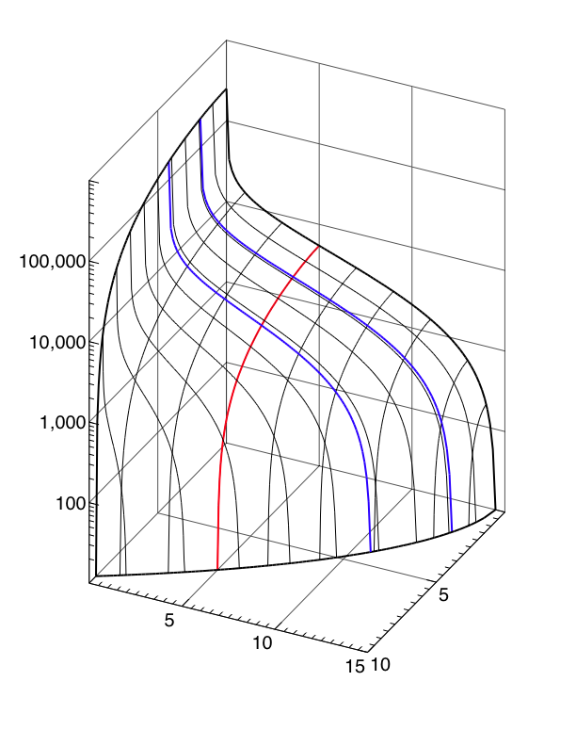
LHC NbTi Wire
J_{c} [A/mm²]
Courtesy L. Boturra of CERN
T=1.9 K
T=4.2 K
Note Improvement in B and Jc
@ T = 1.9 K
B = 5 [T]
100,000
10,000
1,000
100
B [T]
T [K]
5
5
Jc (5 T, 4.2 K) ≈ 3000 A/mm²
10
10
15

Slide 40
But Wait!
What Causes Superconductivity?
The following is a very hand waving explanation of the origin of low temperature superconductivity
There is a very elegant, accurate and complicated description of low temperature superconductivity:
  This is the Bardeen-Cooper- Schrieffer theory or BCS theory
Simply put
  Electrons in the material are linked together into Cooper pairs via an attractive force that comes from the oscillations of the (positively charged) lattice
  These Cooper pairs now act more like bosons and in a sense undergo a Bose-Einstein condensation similar to that seen in He II
  This “condensate” in effect acts as one “unit” you can not scatter or change the energy of a single electron without changing the energy of all of them
    There is thus an energy gap and unless the energy of interactions exceeds this value there is no scattering and thus no resistance
BCS theory explains and predicts observable behavior in low Tc superconductors

Slide 41
Another Way to Model Superconductivity is via the “Two Fluid Model”
This imagines superconducting materials as being composed of two kinds of electrons : Those in Cooper pairs and those not in Cooper pairs
  Above T_{C} there are no Cooper pairs
  At absolute zero all electrons are in Cooper pairs
In DC applications the Cooper pairs carry all the electric current and thus there is zero resistance
But in AC (i.e. RF) applications the oscillating electric field affects both the Cooper pairs & the non paired electrons & the movement of the non paired electrons result in resistance.
  Thus there is always electrical loss in AC superconductivity
A similar model is also used to describe He II

Slide 42
Superconducting Radio Frequency Cavities
From the 70’s to the 90’s the principle application of superconductivity in particle accelerators was in the area of s/c magnets (Tevatron, HERA, LHC)
Since then, for a variety of reasons ( e.g. technical advances in SRF and the growth of linac applications) the use of SRF cavities for particle acceleration has become increasingly important and in many cases is the primary application of superconductivity & cryogenics in accelerator designs

Slide 43
Superconducting RF is Very Popular
Name | Accelerator Type | Lab | T (K) | Refrigeration Capacity | Status
CEBAF | Electron Linac | JLab | 2.1 | 4.2 kW @ 2.1 K | Operating
12 GeV Upgrade | Electron Linac | Jlab | 2.1 | 4.2 kW @ 2.1 K | Operating
ESS | Proton Linac | ESS | 2.0 | 3 kW @ 2 K | Under Construction
SNS | H⁻ Linac | ORNL | 2.1 | 2.4 kW @ 2.1 K | Operating
E Linac | Electron Linac | TRIUMF | 2.0 | 288 L/Hr | Operating
S-DALINAC | Electron Linac | TU Darmstadt | 2.0 | 120 W @ 2.0 K | Operating
ERL | Electron Linac | Cornell | 1.8 | 7.5 kW @ 1.8 K | Proposed
XFEL | Electron Linac | DESY | 2.0 5 -8 40-80 | 2.5 kW @ 2 K 4 kW@ 5 -8 K 26 kW @ 40-80 K | Under construction
ATLAS | Heavy Ion Linac | ANL | 4.7 | 1.2 kW @4.7 | Operating
LCLS II | Accelerator | SLAC | 2.0 K | 8 kW @ 2 K 30.6 kW @ 35 -55 K 2.6 kW @ 4.5 -6 K | Design (2019) TESLA Tech
ISAC - II | Heavy Ion Linac | TRIUMF | 4 |  | Operating
FRIB | Heavy Ion Linac | MSU | 2.1 4.5 33/55 | 3.6 k W @ 2.1 K 4.5 kW @ 4.5 K 20 kW @ 35/55 K | Under Construction

Slide 44
Basics of SRF Cavities
SRF cavities deserve their own course. (see suggested reading list)
This will be a brief overview of the basics of SRF cavities particularly as they affect cryogenics at SLAC.
Practical cavity material is pure Niobium
Cavities have beam vacuum on the inside (usually separate from insulation vacuum) and are surrounded and cooled by a bath of saturated Lhe
Cavities come in all shapes and frequencies (~ 80 MHz – 3.9 GHz) depending on the accelerator design)

Slide 45
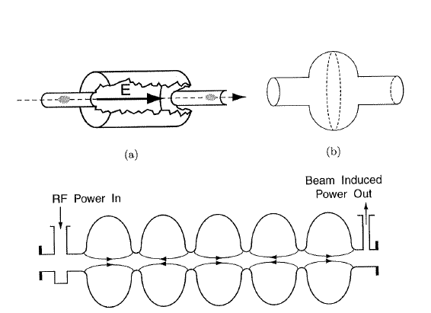
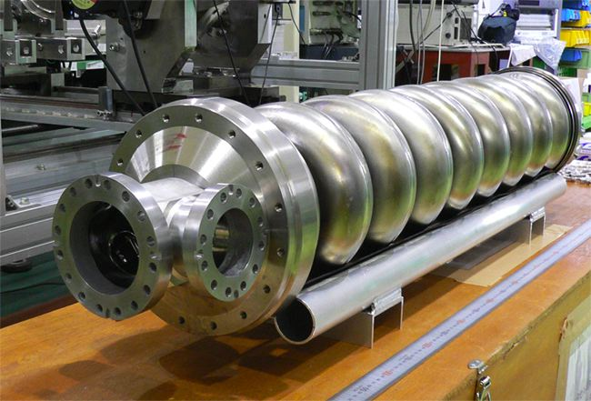
Examples of SRF Cavities
High Beta
  Typically elliptical in design
ILC cavity 1.3 GHz
1 m long – also LCLS II
From H. Padamsee et al.
Superconducting RF for Accelerators

Slide 46
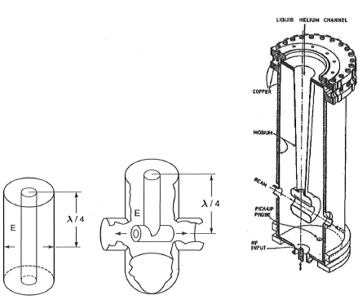
Examples of SRF Cavities
Low Beta
¼ wave & ½ wave cavities
From H. Padamsee et al.
Superconducting RF for Accelerators
FRIB Cavities

Slide 47
Surface Resistance, Frequency and Temperature
The RF surface resistance (which we want to minimize) of a SRF cavity is given by:
The surface resistance goes up with frequency and down with temperature: lower temperature equals less resistance, particularly at higher frequencies
As will be seen, removing heat at lower temperatures is less thermodynamically efficient, thus there is also an energy cost to be paid for operating at lower temperatures.
What is the optimal temperature?
  Above about 500 – 700 MHz you win by operating below 4.2 K ( typically 1.8 – 2 K)
  At lower frequencies (e,g. 80 MHz) you are better at 4.2 K thermodynamically but there may be other considerations (FRIB)
  Between these limits it’s a fairly broad minimum. Most systems operate ~ 2 K – He II

Slide 48
Cavity Performance
Two of the main parameters for describing Cavity performance are the accelerating gradient E_{acc} ( MV/m) and the cavity quality factor Q₀
Q₀ is defined as the energy stored in the cavity divided by the energy lost in one RF period
  Q₀ is related to the surface resistance. The lower the surface resistance the higher the Q₀ and the lower the energy deposited into the cavity wall and cryogenic system Thus the higher the Q_{o} the better

Slide 49
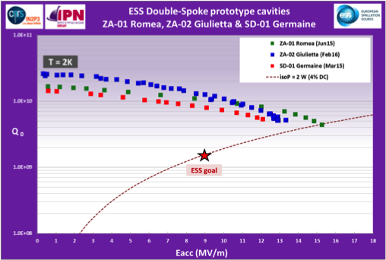
Example of SRF Cavity Performance
ESS Double Spoke Cavities

Slide 50
Cavity Performance Can Be Degraded
By a Number of Phenomena
Quenching or thermal break down – normal ( non superconducting) zones develop in the cavity
Field Emission – electrons are pulled off the surface of the cavity and accelerated by the RF field (degrades Q₀)
Local Magnetic Fields

Slide 51
Cavity Processing
Research has shown that both Field Emission and Thermal Breakdown can be significantly reduced by proper processing of the cavities. This processing consists of an intricate set of steps involving:
  Cavity surface cleaning by chemicals (buffered chemical processing) or by electropolishing
  Cavity surface cleaning by High Pressure Rising with ultrapure water
  Various heat treatments
Major progress in this area has made SRF cavities much more useful
  CEBAF ( 1980’s) designed for 5 MV/m (actual performance was better) CEBAF 12 GeV upgrade (2000’s) specified & met 19.2 MV/m
  ILC cavity specification is 35 MV/m

Slide 52
Cavity Cleanliness
Once processed, the RF surface i.e. the beam vacuum surface of the cavities must be kept extremely clean to maintain performance. This results in:
  Assembly of cavity strings in cleanrooms
  Connection of beam tube vacuums within local cleanrooms during cryomodule installation
  Very strict vacuum and particle free requirements for cavity systems
  Presence of fast acting valves to subdivide beam vacuum in the case of accidents

Slide 53
Other Aspects of SRF Cavities
Q Disease – related to interstitial hydrogen in the niobium.
  Can be treated via heat treatments or may set limits on cavity cool down and warm up rates
Local magnetic fields ( including the Earth’s) degrade cavity performance
  Result is that cavities are designed with passive and sometimes active magnetic shields. Use of magnetic materials near cavities must be carefully examined
Cavities are resonant structures that require tuning frequently at cryogenic temperatures

Slide 54
Other Aspects of SRF Cavities
Vibrations (microphonics) can detune cavities depending on cavity stiffness and design
  This may put strict limits on vibrations near cavities
  Use of He II ( see later lecture) prevents bulk boiling in the helium bath that may affect the cavity tune

Slide 55
Sources of Data for the Cryogenic Properties of Material
“A Reference Guide for Cryogenic Properties of Materials”, Weisend, Flynn, Thompson; SLAC-TN-03-023
Cryogenic Materials Data Handbook: Durham et al. C13.6/3.961 :
MetalPak: computer code produced by CryoData
http://www.htess.com/software.htm
CryoComp: computer Code produced by Eckels Engineering
http://www.eckelsengineering.com/
Proceedings of the International Cryogenic Materials Conferences (ICMC)

